Slide 1
Method of Moving Asymptotes
28 April 2023
Grant Norman

Slide 2
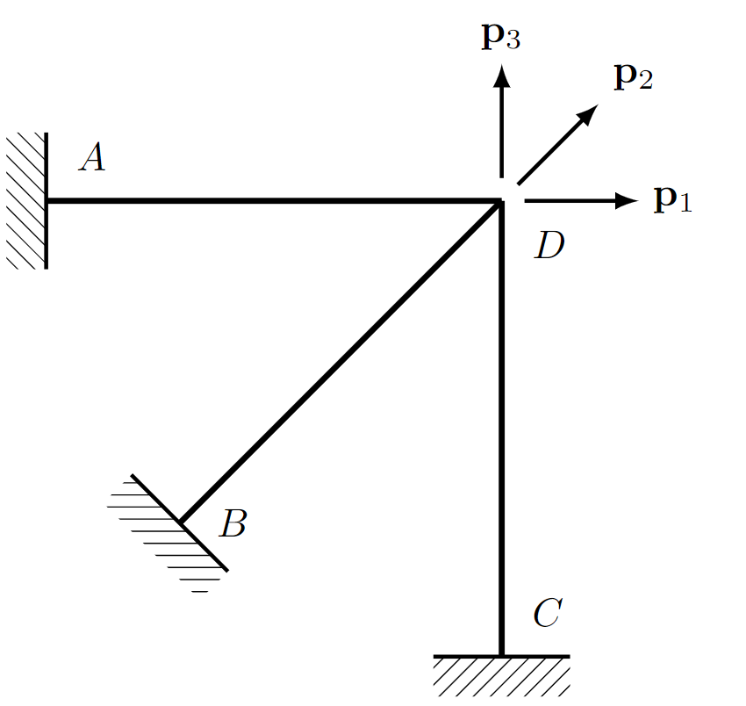
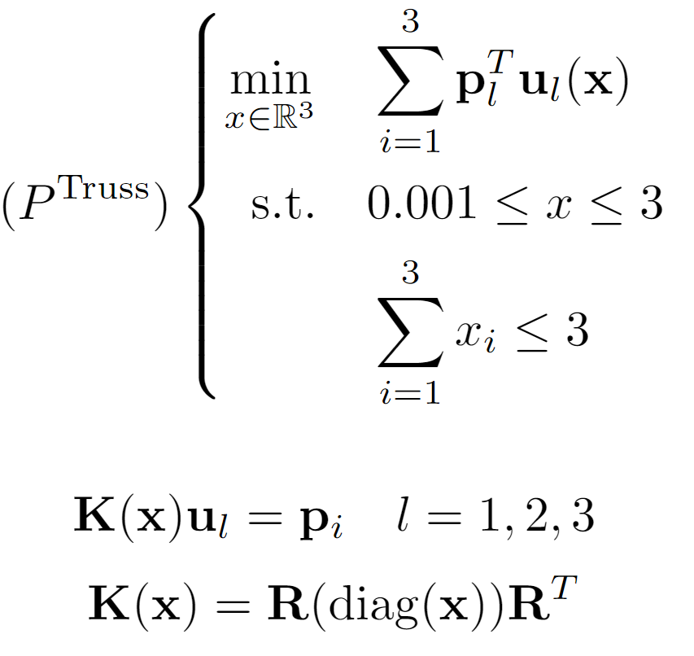
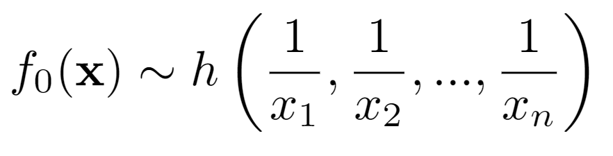
Motivation
Structural Optimization:

Slide 3
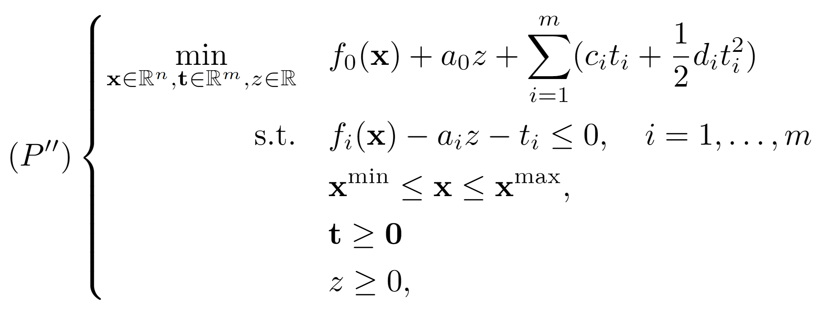
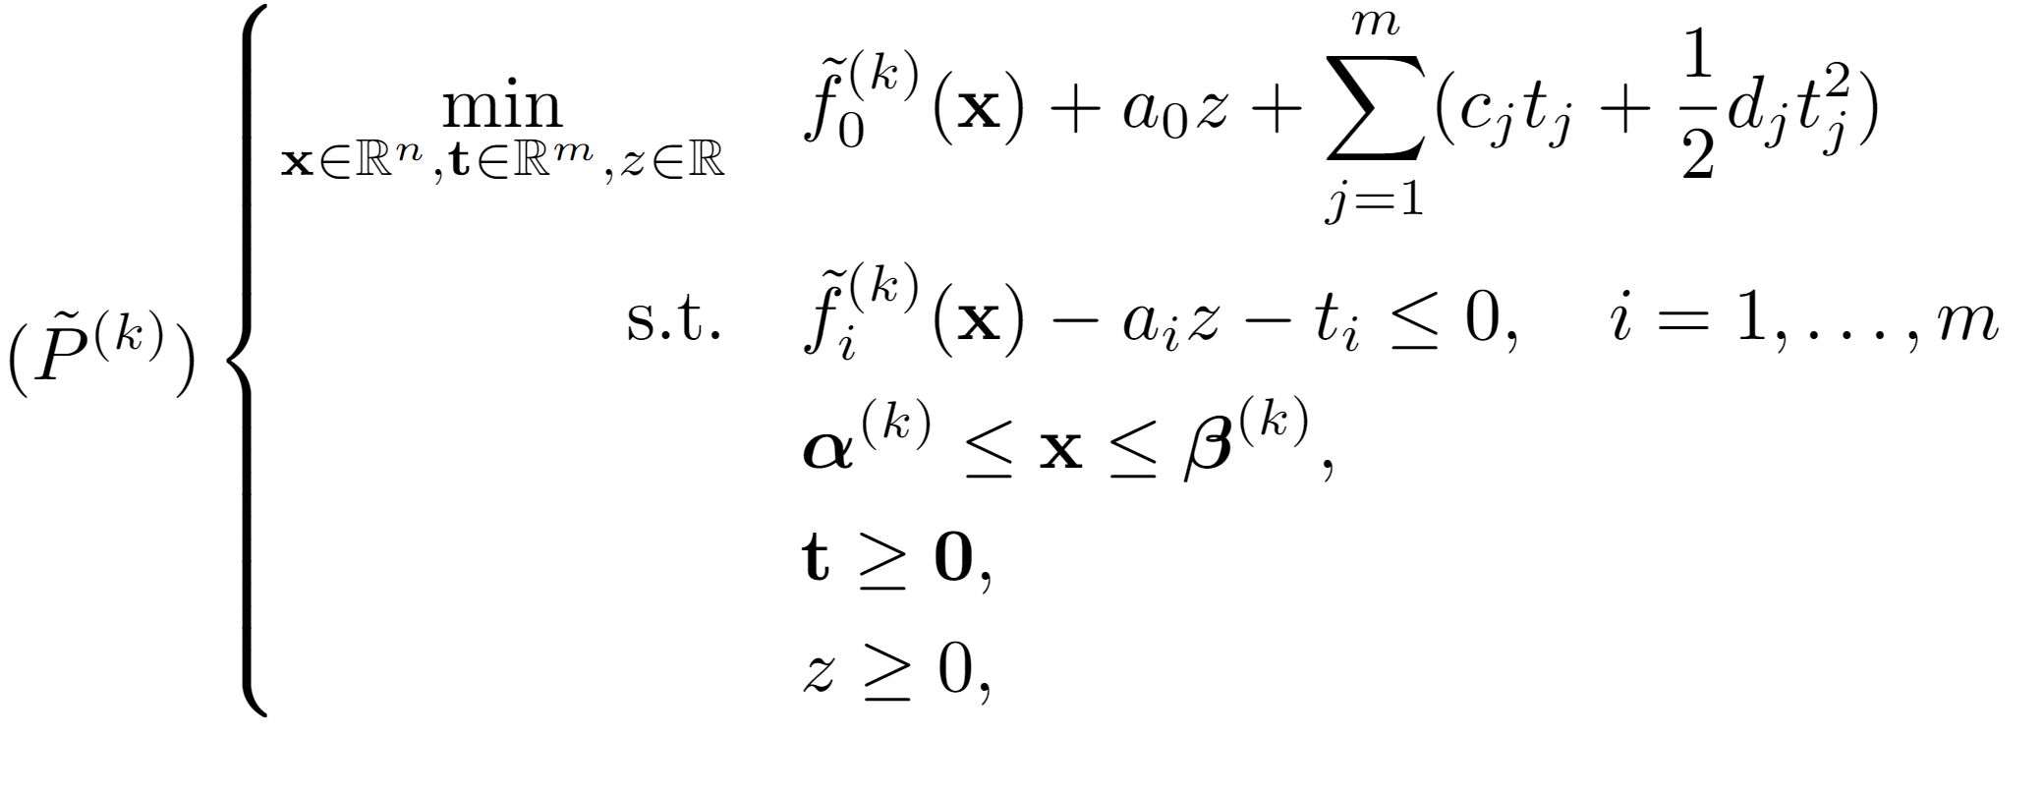
Sequential Convex Program
Solve a sequence of convex subproblems
Moving Asymptotes

Slide 4
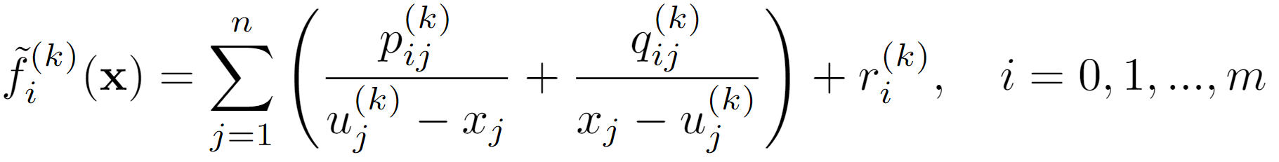
Approximation Functions
Constants computed via problem data at that point
Function Evaluation
Gradient Evaluation
Collecting this problem data is expensive

Slide 5
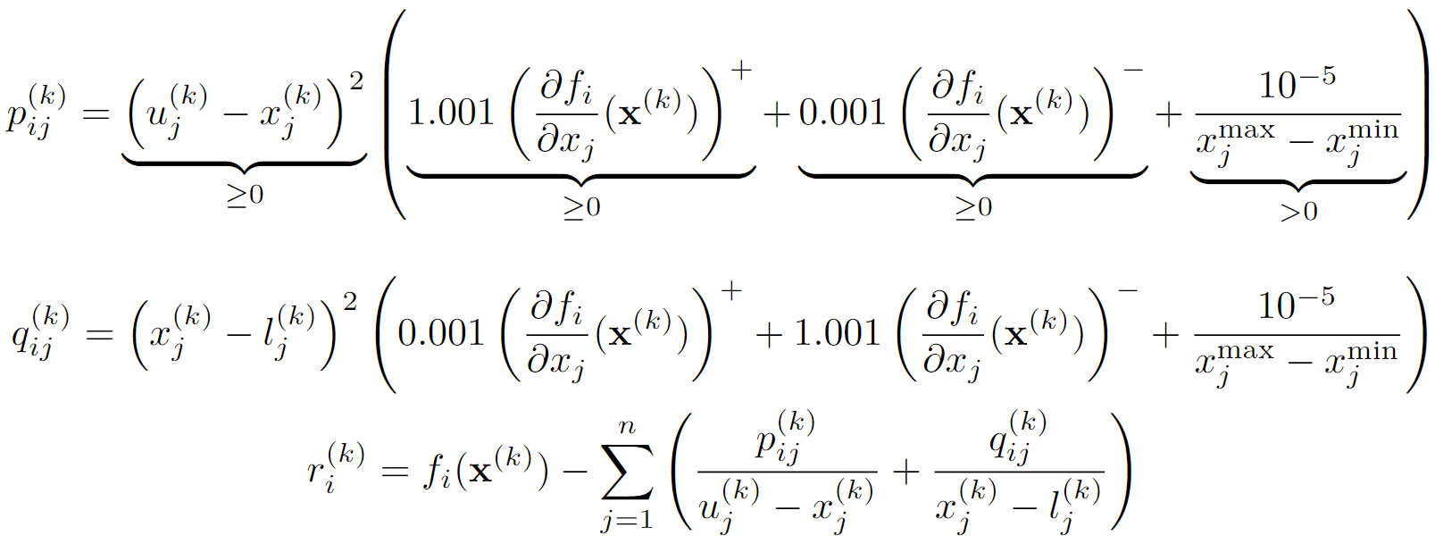
Approximation Functions

Slide 6
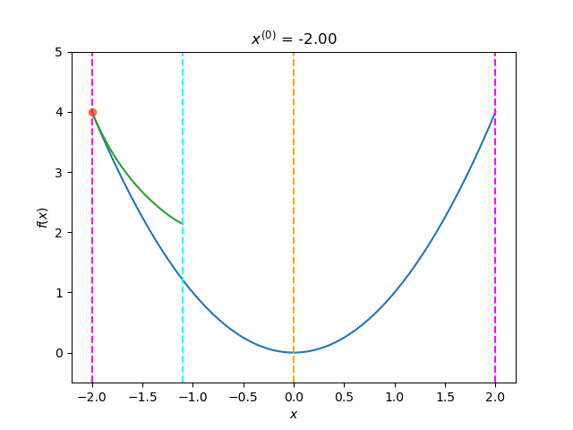
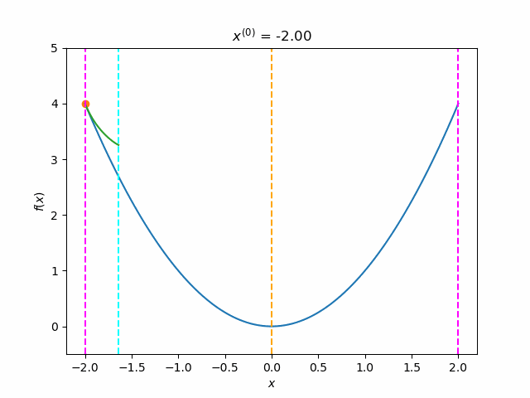
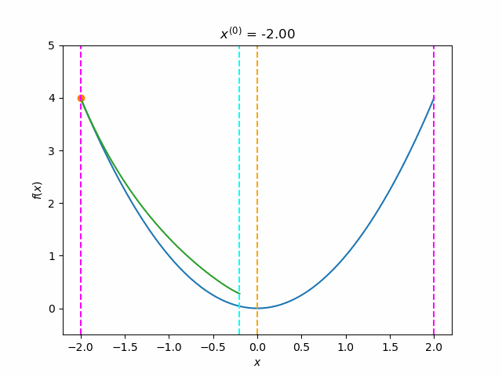
Approximation Functions

Slide 7
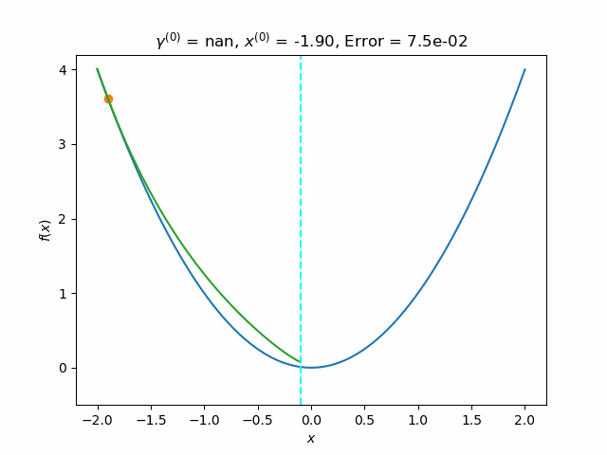
Method of Moving Asymptotes (MMA)
Asymptotes change distance based on success
Two moves in same direction → Expand
Two moves in different directions → Contract
Globally Convergent MMA (GCMMA)
Check if new point is an improvement
Make approximation more conservative if not
Avoid relatively costly gradient computations

Slide 8
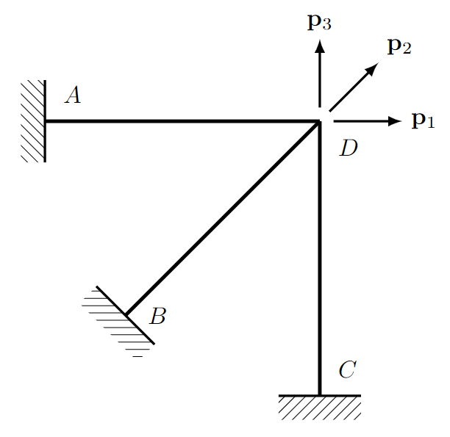
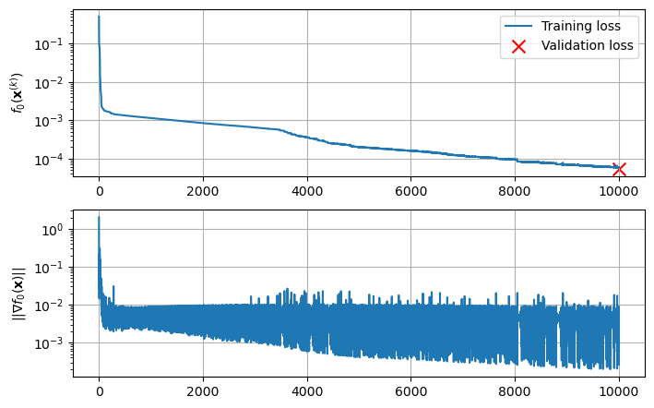
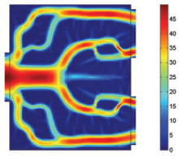
Applications

Slide 9
Adversarial Image
Usually… Train model parameters to decrease the loss, for a fixed image
Use gradients of the loss with respect to the model parameters
ResNet-50
Now… Train an image that when evaluated by a fixed model increases the loss
Now gradients of the loss are with respect to the image pixel values
Dante
Adam vs. GCMMA
We want pixel values between 0 and 1

Slide 10
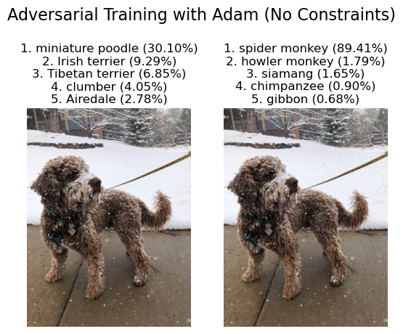

Slide 11
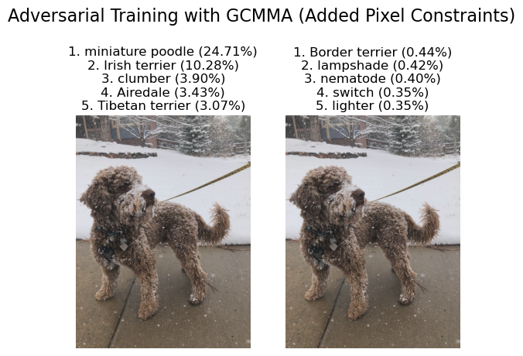

Slide 12
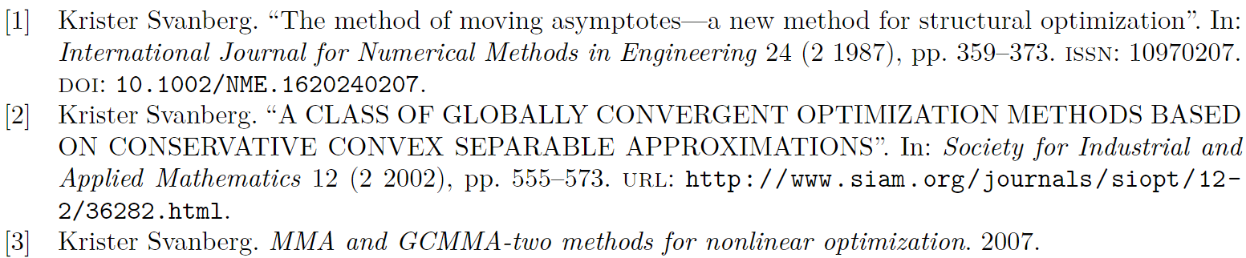
Thank You! Questions?
[4] Szegedy, Christian, Wojciech Zaremba, Ilya Sutskever, Joan Bruna, Dumitru Erhan, Ian Goodfellow, and Rob Fergus. “Intriguing Properties of Neural Networks.” Preprint, submitted February 19, 2014. https://arxiv.org/abs/1312.6199.

